Slide 1
Digital Transformation in Education: Sending Statements via WhatsApp
Presenter : Zamamvula Mkhize

Slide 2
1. Challenges at Institutions
2. About sending student statements via WhatsApp
Why send statements via WhatsApp?
Benefits of sending statements via WhatsApp
Success in Action: Richfield’s Experience
3. From ITS System to Student – In Seconds
4. The Future of Smart Statements
5. Conclusion

Slide 3
Challenges at Institutions

Slide 4
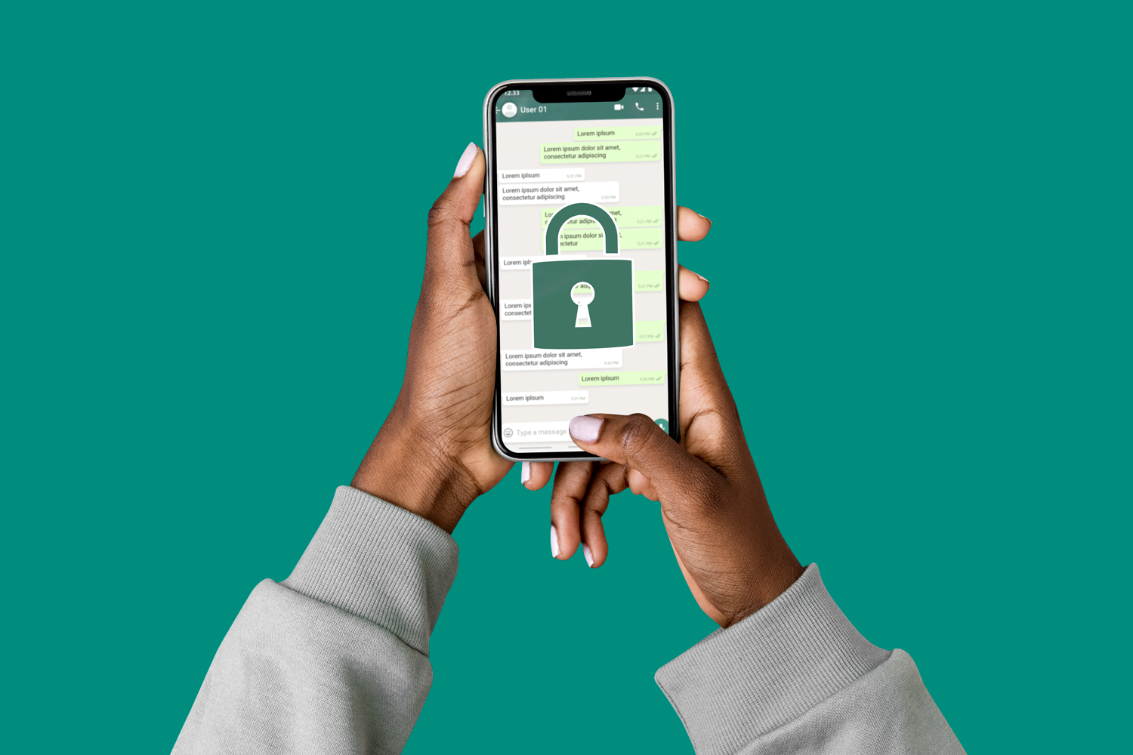
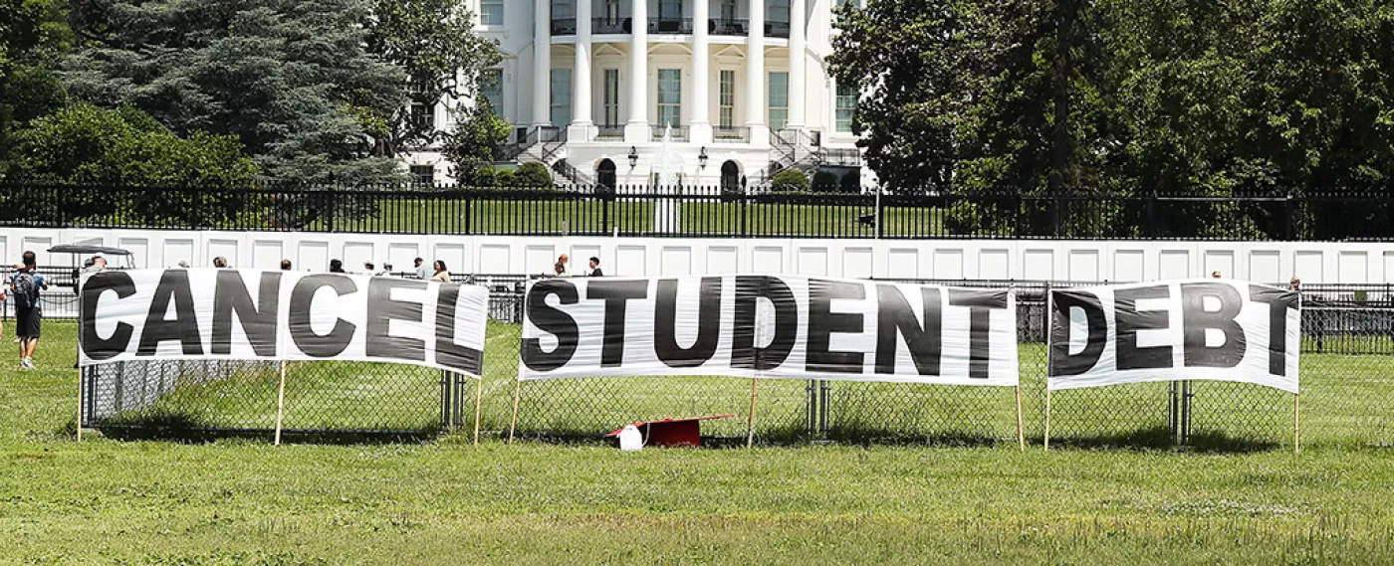
Challenges at Institutions
Security
Queues on Campus
Increasing debt /
Debt collection challenge
Delayed / Inconsistent Statement Delivery
Notes:
Security : Sending statements manually, especially via email or physical mail, can expose sensitive information to security risks like unauthorized access or loss. *Poor Record Keeping*: Without automation, maintaining accurate records of what has been sent and when can be challenging, leading to potential disputes. *Poor Record Keeping*: Without automation, maintaining accurate records of what has been sent and when can be challenging, leading to potential disputes. *Poor Record Keeping*: Without automation, maintaining accurate records of what has been sent and when can be challenging, leading to potential disputes.
Increase debt / debt collection challenge
In South Africa, increasing student debt and debt collection are pressing issues for educational institutions. Integrating technologies like WhatsApp for sending statements can enhance debt collection efficiency. This method ensures timely delivery and better communication, potentially reducing late payments and helping manage escalating debts more effectively.
Queues on Campus
*Administrative Burden*: The manual process places a heavy burden on administrative staff, diverting their time and resources away from other important tasks.
Delayed/Inconsistent Statement Delivery
*Inconsistent Delivery*: Manually sending statements can result in inconsistent delivery times, with some students receiving statements later than others.

Slide 5
About sending student statements via WhatsApp

Slide 6
Why send statements via WhatsApp?
Automation
Effortless
Economical
Automated sending of student statement
Access e-statement anywhere anytime
Reduces costs, enhances efficiency, and ensures timely payments.
01
02
03

Slide 7
Why send e-statement via WhatsApp?
Notes:
Our research highlights an innovative shift in using WhatsApp for student debt collection— a game-changer in financial communication!
Why WhatsApp?
- Seamless & Stress-Free: Makes customer interactions effortless, reducing friction in payments.
- Cost-Effective & Scalable: Cuts costs compared to SMS and emails while boosting engagement.
- Dominating Digital Communication: WhatsApp is outpacing SMS & email in open rates and response speed.
- Built-In Security & Trust: End-to-end encryption ensures safe, compliant transactions.🚀
The future of student debt collection is real-time, secure, and WhatsApp-driven. It’s time to embrace the shift!"

Slide 8
Benefits of sending statements via WhatsApp
Assist Institutions to reduce debt through efficient collection strategies
Reduces costs, enhances efficiency, and ensures timely payments.
Instant delivery ensures prompt access and efficient communication.
Reduced queues on Campus

Slide 9
Success in Action: Richfield’s Experience
“After discussing with the Team, we are happy with the way the system generates the list of students that receive the WhatsApp statements” Arshad Suliman, Richfield

Slide 10
From ITS System to Student – In Seconds
Notes:
How the process works:
Step 1: Student data from ITS
Step 2: Secure integration with CUEDESK
Step 3: Automatic WhatsApp statement delivery

Slide 11
ITS Seamless Integration with CUEDESK
Using CUEDESK as the distributor, we implemented a solution that generates and sends student statements via WhatsApp.
A secure integration with the ITS system, protected by token-based authentication, ensures a seamless and reliable data transfer between the two platforms.

Slide 12
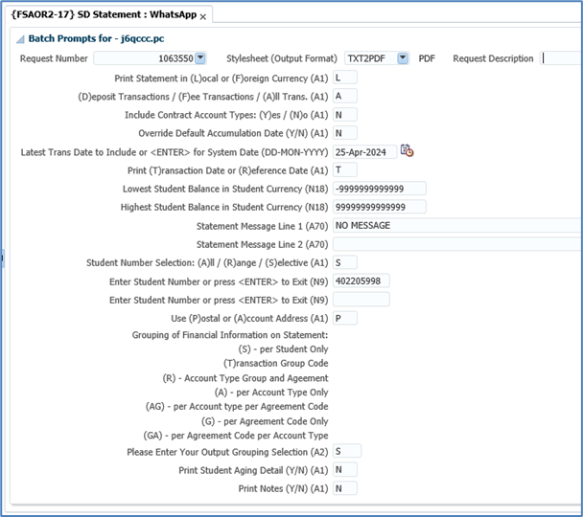
Sending statement via WhatsApp

Slide 13
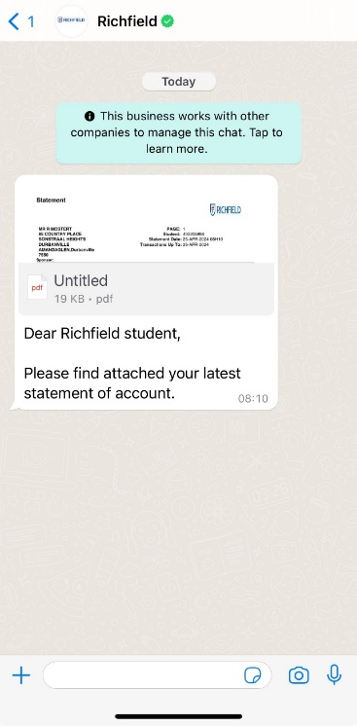
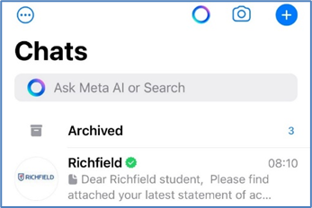
Sending statement via WhatsApp

Slide 14
Sending statement via WhatsApp

Slide 15
The Future of Smart Statements

Slide 16
What’s next?
In Phase 2, students will be able to request their statements directly via WhatsApp, making the process more accessible, user-driven, and aligned with our vision for future service improvements.

Slide 17
Conclusion

Slide 18
Conclusion
WhatsApp for Student statements addresses key challenges in higher education by enhancing communication, reducing costs, and improving engagement.
It offers a secure, efficient, and user-friendly solution that meets the needs of both students and institutions.
By adopting this innovative approach, educational institutions can transform their financial interactions, driving greater efficiency and satisfaction.

Slide 19
Questions ?

